Slide 1
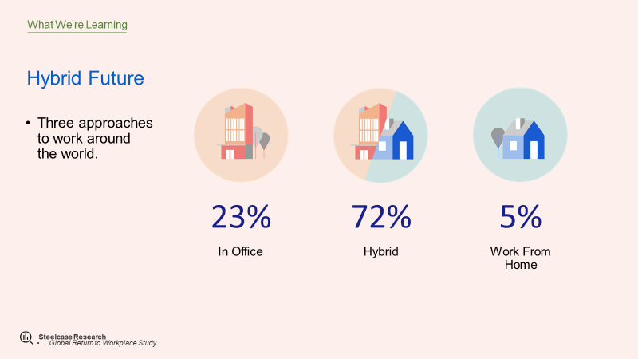
Welcome to Timely Topics with TCN
The Future of Work(shop)
April 29, 2021
Gina Berndt (Perkins & Will).
Jenny Niemann (Steelcase & Forward Space)

Slide 2
Agenda
Research Available
3 highlights and discussion areas today:
  Research Topic 1: Work From Home – Unintended Inequities from Steelcase
  Research Topic 2: Employee perspective on Return To Work (RTW) – From Steelcase
  Research Topic 3: Perkins & Will - Applying the research.
Breakouts to discuss the topics and then report back.
Action Steps

Slide 3
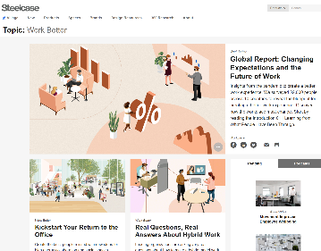
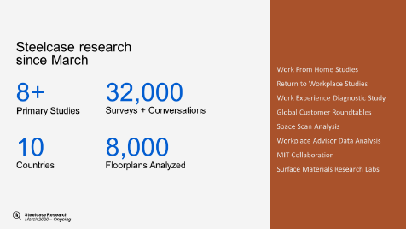
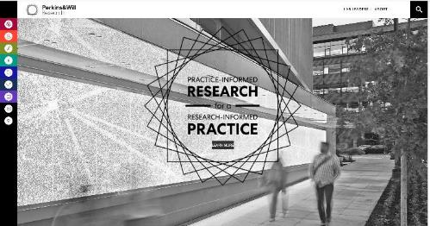
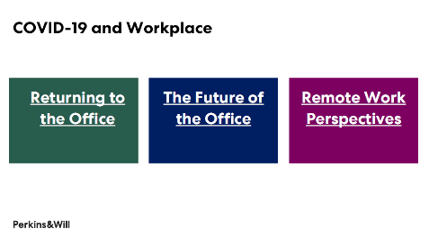
Research Referenced Today:
Global Report: Changing Expectations and the Future of Work
Insights from the pandemic to create a better work experience. Steelcase surveyed 32,000 people across 10 countries to reveal the blueprint for creating a better work experience. Discover how the workplace must change.
https://www.steelcase.com/research/articles/topics/work-better
Perkins & Will has been reviewing and synthesizing research —including there own—that has been conducted throughout this past year to develop data to guide future strategy.
Please also enjoy the summary document related to Covid-19 and the Workplace.
And visit http://research.perkinswill.com
Notes:
This slide is just for us to say…
There are lots of members with research or services to help you with the future of work….
Legal services (what you can do)
Employee engagement
Workplace Design
…..today Jenny and Gina are here from the Workplace design side, and backed by research from Steelcase and Perkins & Will. But we are not here to sell you anything. We did was pull some of the rearch from the EMPLOYEE perspective, so as you think about the business goals related to post pandemic work place and the future of work,….you consider what is on the minds of your employees.
Now let’s talk about the 3 research topics….
Research Topic 1: Work From Home – Unintended Inequities
Research Topic 2: Employee perspective on Return To Work (RTW)
Research Topic 3: Wellbeing learnings from WFH and Covid 19

Slide 4
Let’s get started
Research Topic 1: Work From Home – Unintended Inequities
Research Topic 2: Employee perspective on Return To Work (RTW)
Research Topic 3: Perkins & Will Applying the research.
Notes:
Reference that we (Gina and Jenny) both believe the future will be hybrid (and so do customers based on research).
We’ll spend 5 minutes on each of these and then move into some brainstorm/breakout rooms.

Slide 5

WORK FROM HOME AS A STRATEGY
Research Topic 1: Work From Home – Unintended Inequities
RECRUIT TALENT FROM ANYWERE
REDUCE COST OF REAL ESTATE
BENEFIT TO EMPLOYEES (COMMUTE, FLEXILITY)
SHOWS TRUST
72% of companies globally say they expect to embrace hybrid work policies
Notes:
There are solid business reasons (see bullets) to implement a WFH strategy.
But we also want to share a resent research study, that might point to some reasons for you to think carefully about how you implement this going forward. In Covid – for many companies, EVERYONE went home, but post covid and long term you might need to think about how WFH provide benefits but also challenges for employees. And in some cases even inequities.
Here is some TEXT from the actual research study that we can reference or read…
Working from home during a global pandemic has been tough on everyone in different ways, but new research from Steelcase* shows some people carry a heavier burden than others. The study found extensive work-from-home policies may create unintended inequalities because some people don’t have ideal working conditions at home. Those subpar conditions are linked to a decrease in wellbeing and increase in stress, that, in turn, drives people’s productivity and engagement down.
As 72% of companies globally say they expect to embrace hybrid work policies — working between home and the office to varying degrees — it’s critical to understand how work conditions at home impact people differently and may hinder business results.
These differences lead to groups of “have” and “have not” employees based on their home situation and work set-ups, which are directly connected to their ability to perform. Yet the people making policy decisions for their organizations are more likely “haves” which may result in a hidden bias — a perception that everyone can perform at their best while working from home.

Slide 6
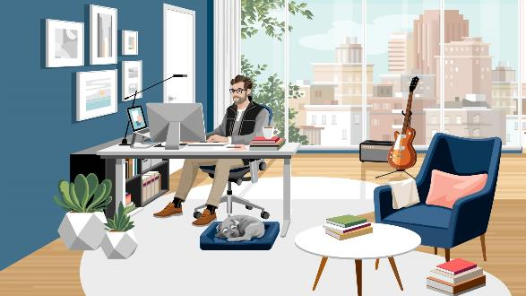
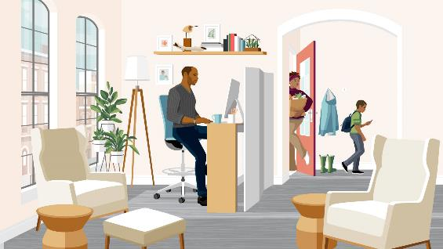
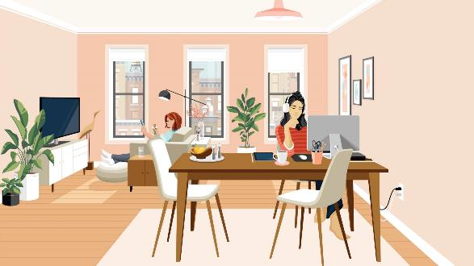
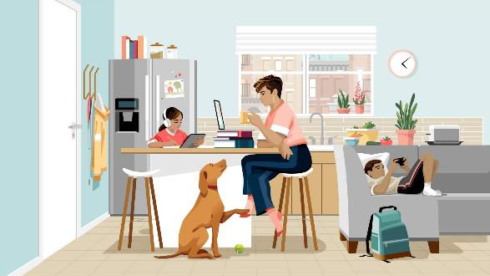
FOUR COMMON WFH SETUPS
Research Topic 1: Work From Home – Unintended Inequities
HOME OFFICE
Some people have the luxury of a private room dedicated to work. It was already functioning prior to the pandemic but was activated as a primary workspace while working from home
WORK ZONE
This is a portion of space carved out within an existing room. New furniture was added to define it as an area for work and make it as functional as possible.
MULTIPURPOSE AREA
Existing furniture and spaces were co-opted to support work, as well as personal activities. People leave their tools and technology in place so the original purpose of the space is compromised over time.
TEMPORARY SET-UP
With minimal modifications, this is an area where people do both work and personal activities. The area reverts to its primary function when not in use for work.
Notes:
Share the 4 types of WHF set ups…..
The text below is from the actual research paper….we could read or summarize this for the side….
*This study was conducted in December 2020 with over 1,800 participants based in the US, France and Germany. It is the latest in a series of studies conducted by Steelcase to un
Steelcase researchers explored four common work-from-home space types to understand the different experiences associated with each space and how they impact people’s performance:derstand the impact of the pandemic on work, workers and the workplace around the world

Slide 7
The net out:
Research Topic 1: Work From Home – Unintended Inequities
There’s a direct correlation between people’s home working conditions and their wellbeing and stress levels, which, in turn, impacts their performance.
Notes:
The text below is from the actual research paper….we could read or summarize this for the side….
Researchers analyzed the demographic patterns, quality of the working conditions and affordances people have (such as high-speed WiFi, desks, ergonomic chairs, secondary monitors, etc), and then examined how those factors impacted people’s wellbeing, stress and key performance metrics, including engagement, productivity and team cohesion.
The net out: There’s a direct correlation between people’s home working conditions and their wellbeing and stress levels, which, in turn, impacts their performance. The better the conditions, the lower the stress and the better the outcome. That’s the good news. The bad news: These benefits are not evenly distributed among workers, which sets up some employees for greater success, and others for greater struggles.

Slide 8

UNINTENDED INEQUITIES
Research Topic 1: Work From Home – Unintended Inequities
The study* found extensive work-from-home policies may create unintended inequalities because some people don’t have ideal working conditions at home.
These differences lead to groups of “have” and “have not” employees based on their home situation and work set-ups, which are directly connected to their ability to perform.
Yet the people making policy decisions for their organizations are more likely “haves” which may result in a hidden bias — a perception that everyone can perform at their best while working from home.
*This study was conducted in December 2020 with over 1,800 participants based in the US, France and Germany. It is the latest in a series of studies conducted by Steelcase to understand the impact of the pandemic on work, workers and the workplace around the world.
Notes:
More of the research article here….
The “Haves” Benefit
Despite images of people lounging on their sofa with their laptop, those with dedicated offices fare the best while working from home. Their productivity hasn’t returned to pre-pandemic levels, but it’s higher than people with other types of work spaces. And their engagement levels have actually grown stronger during the crisis. They have better working conditions, the necessary resources to do their jobs, more visual and acoustical privacy and the right technology tools for collaboration. They’re also more likely to have an ergonomic chair and desk. These things measurably contribute to lower stress levels and higher wellbeing, both of which have a direct correlation to their performance. They’re also more likely to be higher-earning men in leadership roles. In short, a demographic group who was a “have” before the pandemic continues to have a leg up while working from home.
The “Have-nots” Struggle
Meanwhile, the situation is extremely different for people who work in multi-purpose or temporary spaces within their home. Because of the shared nature of these types of spaces, people have less control over their visual and acoustical privacy, experience more interruptions and have more difficulty focusing. They’re significantly less likely to have an ergonomic chair and desk, or amenities like a second monitor. This lack of control and physical discomfort has hurt their wellbeing and led to higher levels of stress, and created a heavier burden for these employees. It’s no surprise they experience lower levels of engagement and productivity. And, sadly, it may not be surprising that the people most likely to work in these kinds of spaces are women, and those further down the corporate hierarchy, with lower incomes. The disadvantages they faced before the pandemic have only been exacerbated during an extended time working from home.
An Inclusive Strategy
The silver lining in these findings is the valuable and actionable insights they reveal. Organizations can use them to shape a better work experience for all employees, which can help boost business outcomes. As organizations better understand how home working conditions impact their employees’ performance and wellbeing, it can help them develop policies and practices that benefit everyone. They can be thoughtful about creating experiences that do not leave some employees feeling isolated or disengaged. They can try to ensure everyone has the affordances they need. While stipends can help, most employees aren’t aware of what changes can make their home working conditions most effective and how to best invest for their productivity. For example, the research showed less than a third of people who work in multipurpose or temporary set-ups have an ergonomic chair, yet this one piece of furniture had an outsized impact on people’s stress and wellbeing, which, in turn, improved their productivity, engagement and feelings of team cohesion.
Yet, working conditions within a home are not entirely within an organization’s control. While leaders can help employees get a better chair or privacy screens, they cannot impact variables such as whether a home has enough space for a dedicated office or is conducive to focus. As organizations decide if or how they will embrace a hybrid model of work, it is important to remember that leaning heavily on home-based work will leave some employees with a heavier burden than others. They can take steps now, while planning their return-to-office strategy, to ensure the workplace is an equalizer, offering equitable conditions and amenities to everyone. At its best, it can be designed for inclusion and create a community in which people and the business thrive — a place that is so appealing people choose to go there to do their best work.
Is it likely leaders will still have access to better spaces and technology than other employees? Possibly. But the potential bias created among people working extensively from home can be mitigated if organizations help their employees create better working conditions both at home and the office to help people feel a sense of belonging — offering the safety, comfort and control people need to be productive and engaged.

Slide 9
How can leaders address unintended WFH inequities?
Research Topic 1: Work From Home – Unintended Inequities
Ensure leaders avoid hidden biases when making WFH decisions?
Policies?
Measures?
Management involvement + Employee Engagement actions?
Home office set up requirements?
Be intentional (and careful) about mandating work from home (or allowing the choice).
Notes:
Is it likely leaders will still have access to better spaces and technology than other employees? Possibly. But the potential bias created among people working extensively from home can be mitigated if organizations help their employees create better working conditions both at home and the office to help people feel a sense of belonging — offering the safety, comfort and control people need to be productive and engaged.

Slide 10

RETURN TO THE OFFICE AS A STRATEGY
Research Topic 2: Employee perspective on Return To Work (RTW)
COLLABORATION
INNOVATION
CULTURE
ONBOARDING/TRAINING

Slide 11
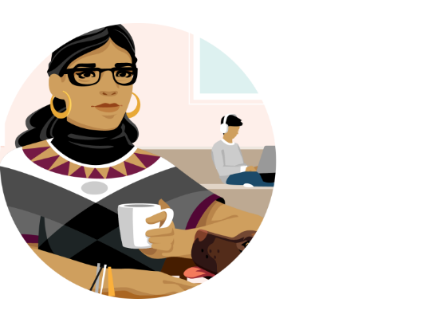

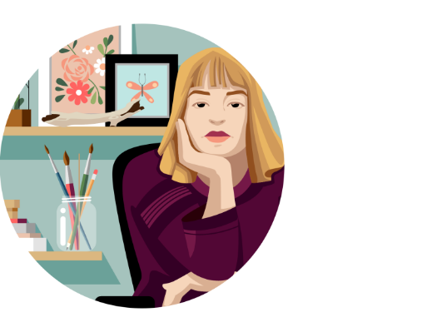


FIVE PATTERNS OF WFH EXPERIENCE
Research Topic 2: Employee perspective on Return To Work (RTW)
To better understand the nuances of how people feel about working from home, Steelcase researchers augmented quantitative data by interviewing people in North America and Europe for deeper insights. They found the experiences people described fell into five patterns of behavior and attitudes.
Overworked Caretaker
Home office is a nonstop flow of competing demands
Relieved Self-Preservationist
Home office is the only place I am safe
Frustrated Creative Networker
Home office is a suspension from normal life and work
Autonomy Seeker
Home office is freedom
Isolated Zoomer
Home office is a lonely cage
Notes:
Five Patterns of Work-From-Home Experiences
To better understand the nuances of how people feel about working from home, Steelcase researchers augmented quantitative data by interviewing people in North America and Europe for deeper insights. They found the experiences people described fell into five patterns of behavior and attitudes.
It’s important to note that it’s possible for people to associate themselves with more than one of the patterns. They are meant to be extreme categories that can help us understand the different experiences people have had and what their expectations may be when they return to the workplace.
Overworked Caretaker
Home office is a nonstop flow of competing demands
This person is torn between meeting work responsibilities and managing family needs. Their long, jam-packed day is chopped between meetings, focus work, homeschooling and domestic chores. Exhaustion and guilt are piling up. They take comfort in finally being allowed to show they are parents and not worry if their kids are heard on a call. They miss the office for the opportunity to leave home responsibilities behind and have control over their attention. But they appreciate the flexibility to work from home as needed to more easily manage between their family and work responsibilities.
Relieved Self-Preservationist
Home office is the only place I am safe
This person’s main concern is not COVID; it’s their psychological safety. They feel their company is creating a hostile work environment and working from home has been a welcome respite from an organization they feel does not appreciate them. They’re less anxious and more productive, able to focus on work, rather than managing relationships. Working from home gives them a more human experience that allows them to work in a space that is their own.
Frustrated Creative Networker
Home office is a suspension from normal life and work
These individuals are conflicted about returning to the office. They spend most of their day co-creating, coaching, persuading and connecting the dots — work done much better in the office, especially with larger groups. But although they desire the benefits of the office, they don’t think it’s safe to return. They have quickly adapted the use of digital tools, but they crave more — virtual meeting technology is still too limited for creative collaboration and informal, spontaneous connections across silos. COVID has been a huge challenge when they suddenly found themselves cut off from in-person interactions that drive their work. With limited tools and a lack of experience in making them work, they have shifted focus to more individual tasks done more easily from home.
Autonomy Seeker
Home office is freedom
Thrilled to work at their own rhythm, without someone constantly looking over their shoulder, this person feels just as productive at home as before, if not more. They feel a greater sense of wellbeing at home, where they can look out the window, sit in different postures, cook healthy meals and weave in activities that help them recharge and relax, such as hanging out with their pet. They especially enjoy the level of control they have in designing their own work experience to curate a schedule that braids together life events and work events.
Isolated Zoomer
Home office is a lonely cage
This person lives alone without any self-imposed boundaries to keep to a healthy work schedule. They’ll return to the office when they trust their employer has taken necessary precautions. They value the office because it offers a way to separate work and life. Days are spent on back-to-back Zoom calls, and despite constant interaction, they feel disconnected. They miss daily social interactions with their colleagues — a major reason they come to the office. Relationships and their support system at work make it easier to navigate challenges.

Slide 12
How can leaders help employees return to a better workplace?
Research Topic 2: Employee perspective on Return To Work (RTW)
Understand the WFH experience was different for each person
Consider how employees feel coming back. Survey them. Have managers talk to them.
Create a workplace that is so appealing people CHOOSE to go there to do their best work.
Notes:
What can leaders do?
They can take steps now, while planning their return-to-office strategy, to ensure the workplace is an equalizer, offering equitable conditions and amenities to everyone. At its best, it can be designed for inclusion and create a community in which people and the business thrive — a place that is so appealing people choose to go there to do their best work.

Slide 13
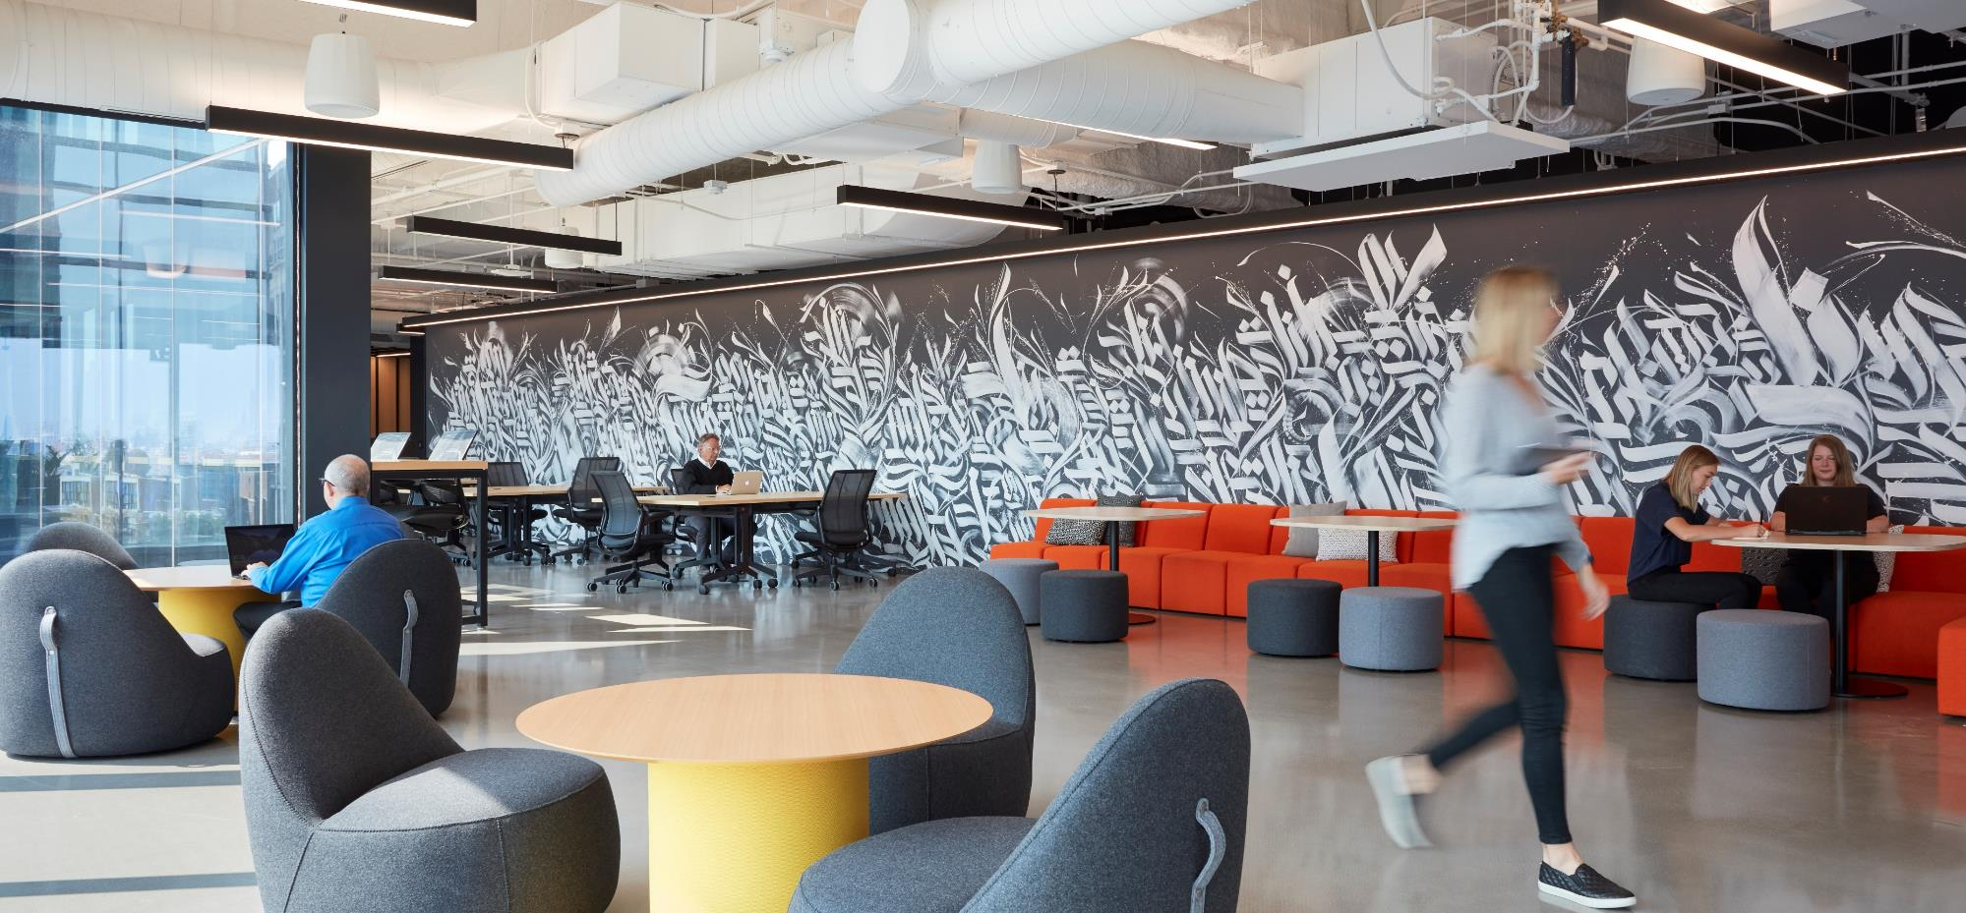
Research Topic 3: Perkins & Will – Applying the Research
The Future of the Workplace

Slide 14
Research Topic 3: Perkins & Will – Applying the Research
What has changed—and what hasn’t—since April 2020?
Notes:
The past year has deeply challenged us. We’ve worked to support colleagues and clients amid a global pandemic that brought systemic inequalities into harsh light. While this past year has changed so much about how we live and work, some things have only grown in their importance. Let’s start by setting the context for where we find ourselves at this moment.

Slide 15
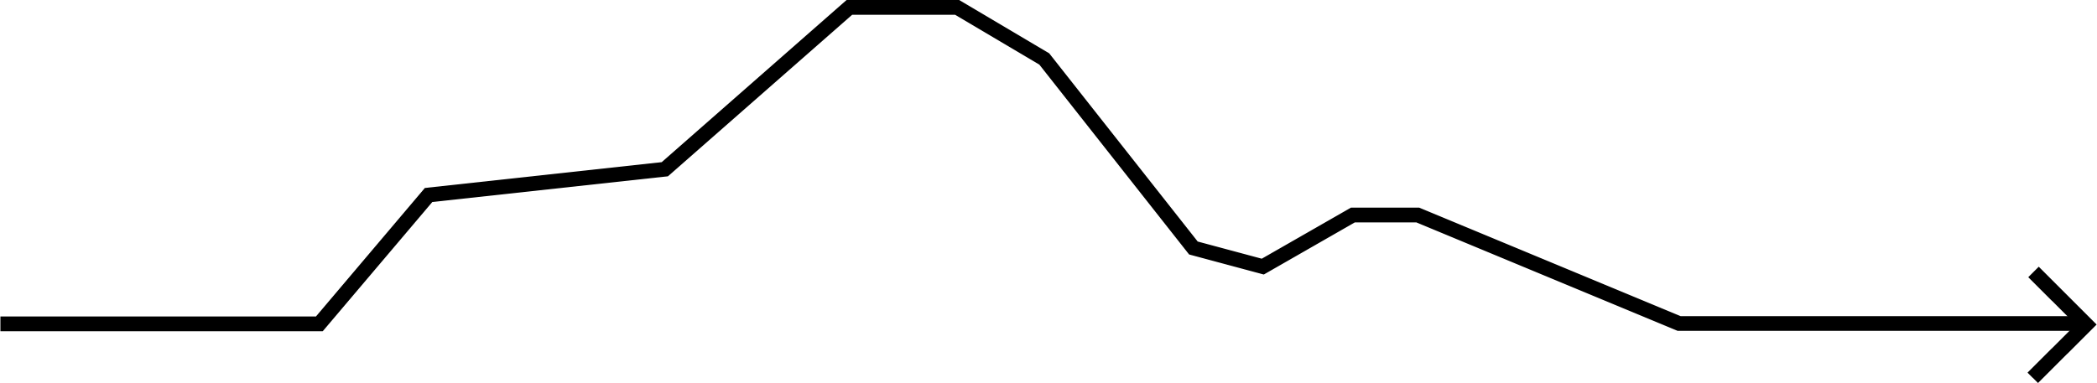


Research Topic 3: Perkins & Will – Applying the Research
We’re in a different phase of the pandemic.
Transition
Interim workplace options are established to address reasonable protection in the workplace.
Future Planning
On-going policies / protocols are adjusted to integrate new ways of working and optimize workplace well-being.
Response
Workplace restrictions follow government regulations.
We are here
Interpandemic Phase
Alert Phase
Pandemic Phase
Transition Phase
Interpandemic Phase
Risk Assessment
Preparedness
Response
Recovery
Preparedness
Image credit: WHO Pandemic Influenza Risk Management, WHO Interim Guidance, 2013
Notes:
Michelle
WHO phases of a pandemic
We are not truly in a post-pandemic world. Our locations are emerging from the pandemic on different timetables and we may continue to see a cycle of workplace restrictions related to additional pandemic waves and variants. This project is focused on planning for a future that goes beyond the transition steps of adding pandemic protocols to our workday. For example, developing strategies for distancing, masks, and temporary protocols is not the goal of this effort. We are looking beyond those immediate concerns to the new ways of working will we embrace after the transition and how we may incorporate new workstyles and choices into our approach going forward.
Alyssa’s suggested text: With the development of effective vaccines, we are beginning to enter the recovery phase of this pandemic, per this World Health Organization graphic. Every day we’re hearing more conversations about solidifying return-to-office plans and getting questions about how to support newly hybrid workforces. This marks a shift from questions early in the pandemic about panel heights and desk spacing, but these conversations show that we are not simply going back to business as usual.

Slide 16





We now have valuable data to inform our next steps.
Research Topic 3: Perkins & Will – Applying the Research
Notes:
Thankfully, a variety of organizations—including our own—have conducted research throughout this past year to develop data to guide our future strategy.

Slide 17




Research Topic 3: Perkins & Will – Applying the Research
Our return-to-office guidance remain rooted in science, safety and well-being.
Safe
  Health first and cautious
  Data-/science-driven
Transparent
  Open and inclusive
  Engagement-based
Flexible
  Agile and nimble
  Adaptable
Consistent
  Fair and equitable
  Risk-managed
Notes:
Ultimately, our own plans and guidance for clients remain grounded in these principles.

Slide 18
Research Topic 3: Perkins & Will – Applying the Research
What does the research tell us?

Slide 19
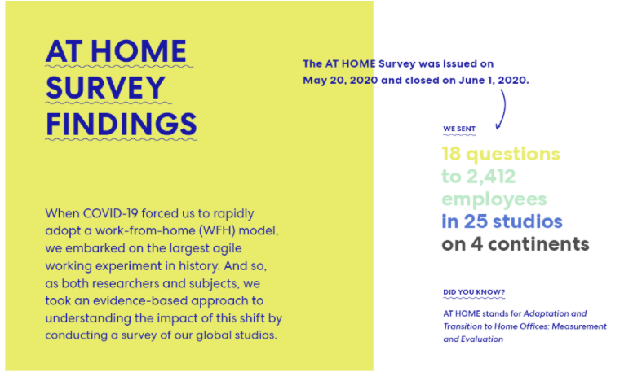
Research Topic 3: Perkins & Will – Applying the Research
Perkins&Will
AT HOME Survey
Our Planning and Strategies team partnered with our Human Experience Lab early in the pandemic to craft a survey measuring how we were faring while working from home.
Notes:
As a research-based firm, we knew we wanted to study our own experiences of working at home. Our Human Experience Lab and our Planning and Strategies team worked to develop the AT HOME Survey, which asked Perkins&Will employees a series of 18 questions about their ongoing work from home experience.

Slide 20
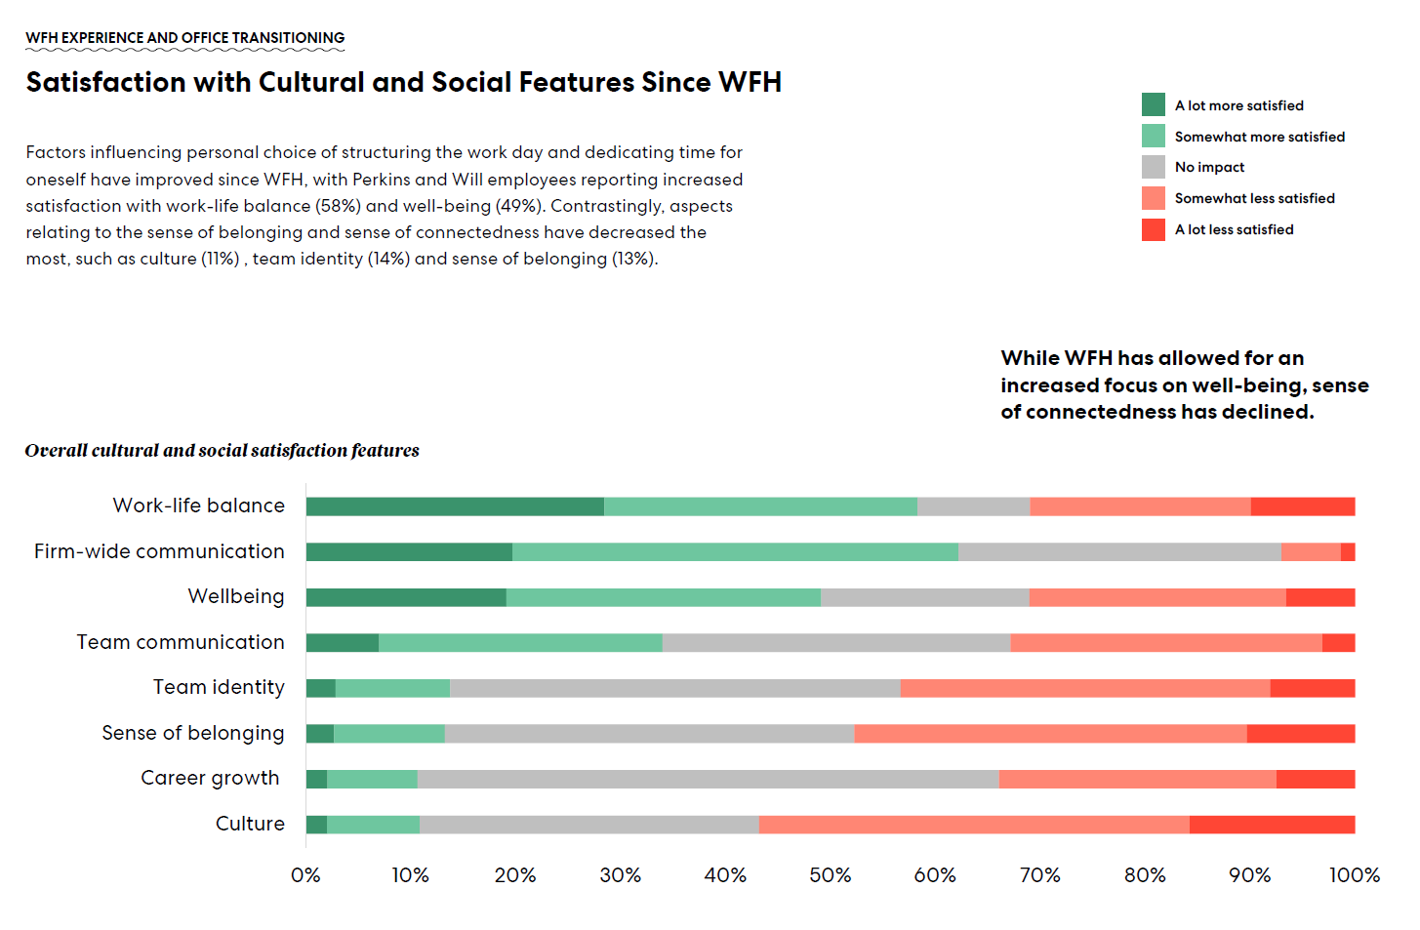
Research Topic 3: Perkins & Will – Applying the Research
Our well-being improved, but we felt less connected to our colleagues.
Notes:
Among our findings, we reported an increase in our well-being. However, our sense of belonging and connectedness dropped. We’ve since worked with clients on surveying their employees, and combined with external surveys and research, we’re starting to see a richer picture of what’s working while at home and what’s not.

Slide 21
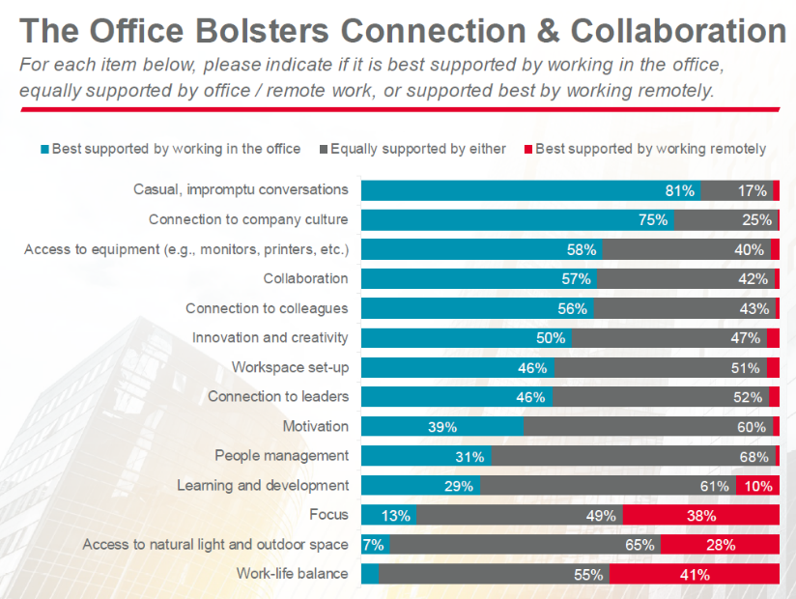
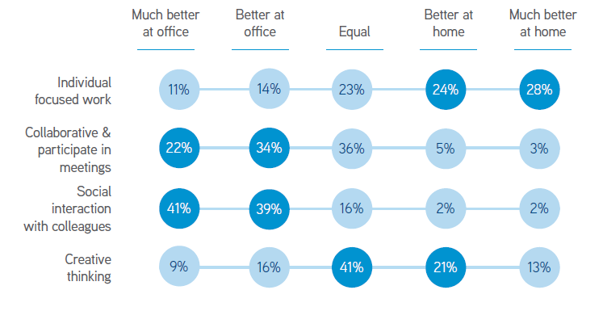
Research Topic 3: Perkins & Will – Applying the Research
Certain tasks are well-suited to the home office, but home working experiences vary.
Source: Implications of COVID-19 on the Workplace, Colliers International, September 2020
Source: Workplace Ecosystems, Cushman & Wakefield and CoreNet, April 2021
Notes:
One reason we are not ready to throw in the towel on workplace is that despite an overall rosy picture of productivity from employees – when pressed about specific activities – we start to see that not everything is more productive at home.
In this Colliers survey of over 5,000 employees’, we see that
Individual work – tended to be better or much better at home
Collaborative meetings and socializing with colleagues – tended to be better or much better in the office
Creative thinking – somewhere in the middle with a more neutral to slightly better at home.
What is also striking about these results is that responses might be stronger for one setting over another but there is by no means a universal agreement on which setting is best. Even when 50% of people say that focused work is better at home there are still 25% that say it is better or much better at the office.
And there is a simple reason for that … because working from home is not the same for everyone.
This recent survey by Cushman & Wakefield and CoreNet echoes this lack of universal agreement—while casual, impromptu conversations thrive in the office, collaboration, innovation, and connection to colleagues are equally supported at the office and at home.
So when we ask “what would you choose to do in the office?” It is a personal question because we do not all have the same choices.

Slide 22
Research Topic 3: Perkins & Will – Applying the Research
Employees want flexibility, which pre-dates COVID-19
83%
of employees want to continue working from home one day a week or more
Source: Implications of COVID-19 on the Workplace, Colliers International, September 2020
Notes:
Even before the pandemic, employees have been driving the conversation to incorporate more remote working.
83% of employees surveyed by Colliers report that they want to continue working from home one day a week or more.
Colliers goes on to say that their feelings of productivity and improved work-life balance are the main drivers behind the desire to work from home.
In the past having the flexibility to work remotely was largely considered a benefit to employees. Something that a company offered to retain talent. However, statistics like this and the sheer length of time we’ve spent working at home successfully is shifting remote working from a “nice-to-have” to an expectation. One that many will feel they earned over the course of the pandemic.

Slide 23

Research Topic 3: Perkins & Will – Applying the Research
Employees want flexibility, which pre-dates COVID-19
83%
63%
Agree that their home environment enables them to be productive
Feel that way about their office
Source: The Impact of Home Working on Employee Experience, Leesman Index, September 2020 (Global Statistic)
Notes:
If you look at the high-level statistics being reported around our feelings of productivity, it is quite remarkable …
This is from 125,000 survey responses conducted by the Leesman Index - across 873 workplaces in 83 countries. April through September of 2020
During the pandemic – 83% of people reported that their home environment allows them to be productive, that is contrasted by the 63% who felt that way about their office before COVID-19.
Before covid – Leesman would consider your workplace as “highly productive” if you reached a 78%. So many of the top ranked office environments cannot not beat the currently self-reported home working productivity.
So why are we not declaring the office dead, moving everyone home, and calling that a business victory?

Slide 24

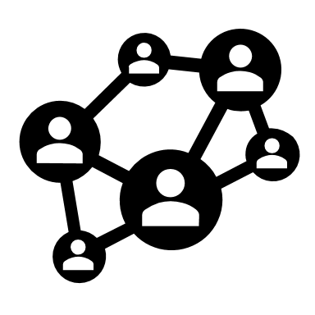
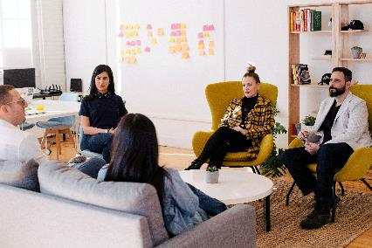
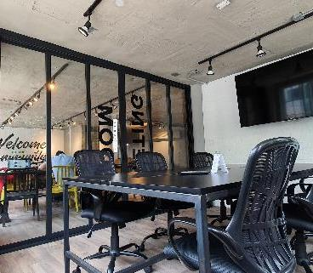

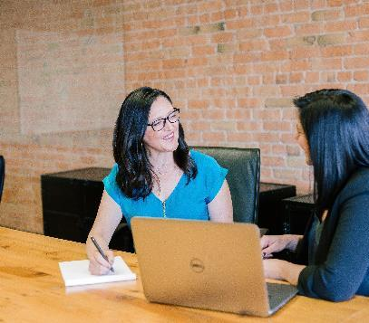


Research Topic 3: Perkins & Will – Applying the Research
What experiences do people want?
Social interaction and team collaboration
Inspiration, creativity and opportunity for innovation
Access to things not supported in home offices
Professional development and mentorship
Notes:
Because across many surveys, we’re seeing that people want the experiences on this screen—which likely won’t surprise you. We’ve been talking about these for a long time in design.
These experiences are attributes of a strong community, along with trust, inclusivity and resilience. In turn, a strong community correlates with key business outcomes — engagement, productivity, innovation and retention. The workplace will still play a role in intentionally fostering meaningful interactions, but it may may not look like it did before, because before we were always balancing that with building a seat for every person and that may be changing. The role workplace can play is to signal that change and adaptation are part of the culture and something to be embraced.
This is why we think that digging deeper into the high-value activities, will be important to the future workplace.
Reference:
https://www.steelcase.com/research/articles/work-better/?utm_source=forbes&utm_medium=tb-article&utm_campaign=work-better&utm_term=work-better-article

Slide 25




Tenets of our New Normal
Research Topic 3: Perkins & Will – Applying the Research
Place matters
Studios drive collaboration - and promote coaching, mentoring and on-going learning
Places generate Energy, Excitement and Engagement – our design culture thrives on this ambience
Balance @Work
Personalization matters
Community matters
We need to be flexible around work-styles and methods – aligning individual and studio needs.
We need to promote quality over quantity – and be careful about an always-on culture
Flexibility matters
Notes:
As we move forward as a firm, we’re focusing on balance at work—taking the lessons we’ve learned from this past year and using them to do our best work.

Slide 26

Agenda
Research Available
3 highlights and discussion areas today:
  Research Topic 1: Work From Home – Unintended Inequities from Steelcase
  Research Topic 2: Employee perspective on Return To Work (RTW) – From Steelcase
  Research Topic 3: Perkins & Will - Applying the research.
Breakouts to discuss the topics and then report back.
Action Steps

Slide 27
BREAKOUTS
We have 3 questions.
Please enjoy the discussion and have someone ready to share highlights from your breakout when we regroup.

Slide 28
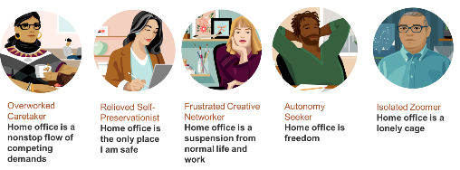
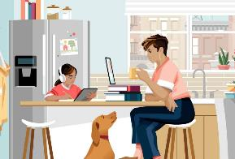
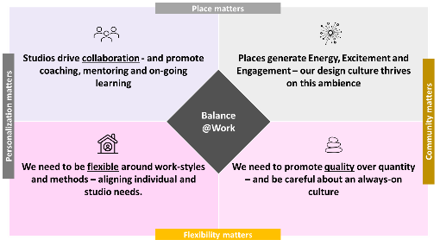
BREAKOUTS
We have 3 questions. Please enjoy the discussion and have someone ready to share highlights from your breakout when we regroup.
Question 1:
If returning to the office (even hybrid) is part of your business strategy, how will you consider employee perspectives/personas?
Question 2:
If you have business reasons for wanting employees to work from home (attract talent, choice, commutes, cost savings) how can you implement your WFH strategy without creating inequities and burdens arising from different at home working environments and conditions?
Question 3:
Perkins & Will discussed applying research. How is your organization defining their future workplaces strategies and what research are you (or will you) use?

Slide 29
Report outs by group.

Slide 30
ACTIONS AND NEXT STEPS
Check out the reading list provided.
Review parts of this presentation with leaders in your organization.
Develop cross functional leadership collaborative: HR, IT, Facilities/Real Estate, Finance, Legal.
Define your strategies and policies with employee perspective in mind.
Talk to peer and industry groups for their ideas and best practices.
Define and engage in change management.
Try a survey or focus group engage employees.
Ask these questions:
  What do individuals need to RTW?
  What do organizations need from employees?
  What do teams need to thrive?
Strive to return to something better than we left.
Call Gina or Jenny
Gina Berndt
Gina.Berndt@perkinswill.com
Jenny Niemann Jniemann@forwardspace.com
https://www.steelcase.com/work-better-contact-us/#heres-how-we-can-help You can request a survey, workshop, pilot, consulting or other tools.

Slide 31
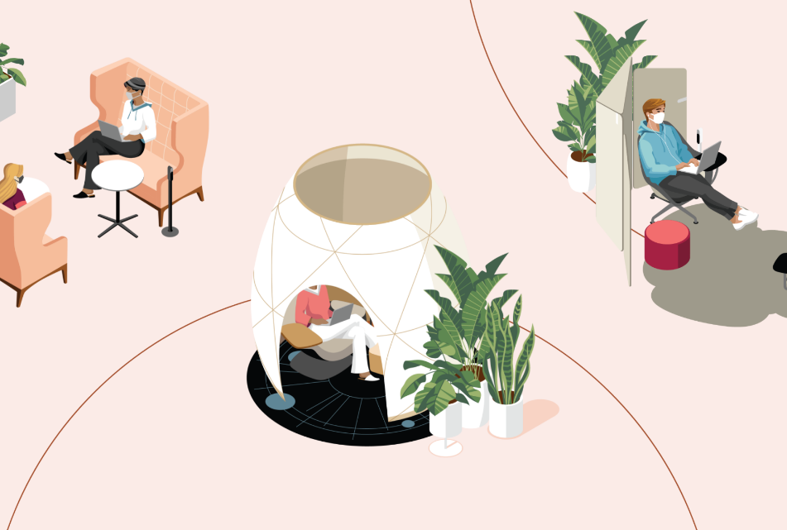
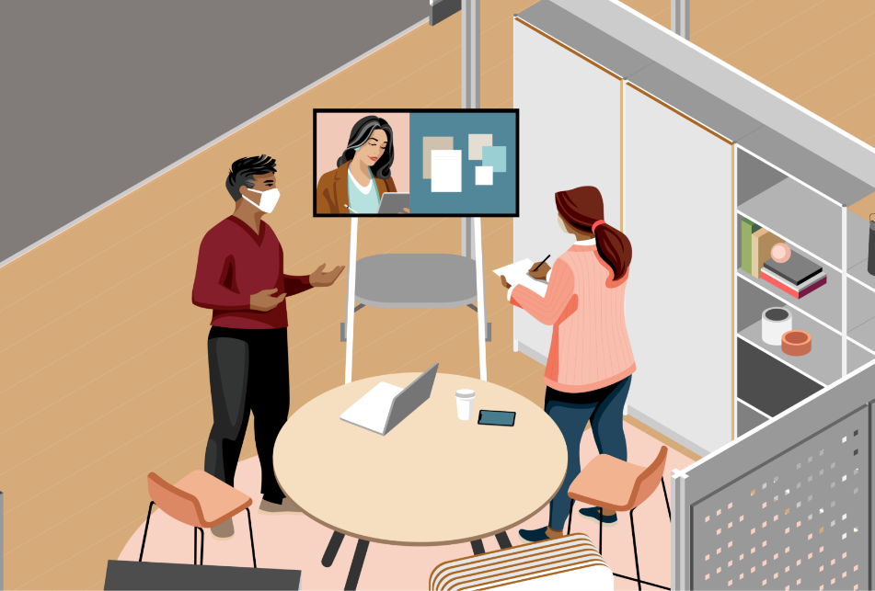
It is time for an experience that is fundamentally better thank you

